Slide 1
Analysis of Time Series Models for Electricity Consumption Forecasting
Qianqian Yao
Notes:
My project is titled as …

Slide 2
Contents
Background of Time Series Analysis
Project motivation
Data
Models
Conclusion
Notes:
During this project,

Slide 3
Background of Time Series Analysis
A Time Series is a collection of observations $x_{t}$, each of which is indexed by time t, ie., the observation $x_{t}$ is made at a specific time t.
A Time Series Model for the observed data {$x_{t}$} is a specification of the joint distributions (or possibly only the mean and covariance) of a sequence of random variables {$X_{t}$} of which {$x_{t}$} is postulated to be a realization.
Objectives of Time Series Analysis: Modeling and Forecasting
1- set up a probability model to represent data;
2- estimate parameters in the model;
3- check the goodness of the model fit for the data;
4- use the fitted model to enhance our understanding of the mechanism generating the series;
5- once the probability model has been established, we may use it to summarize the data or forecast (predict) the future values, etc.
Notes:
What is outliers?
Outliers and anomalies can be used interchangeably.

Slide 4
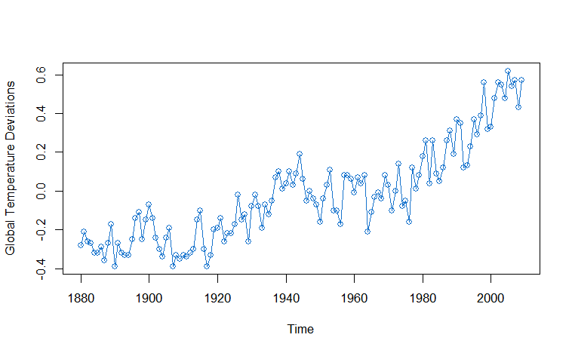
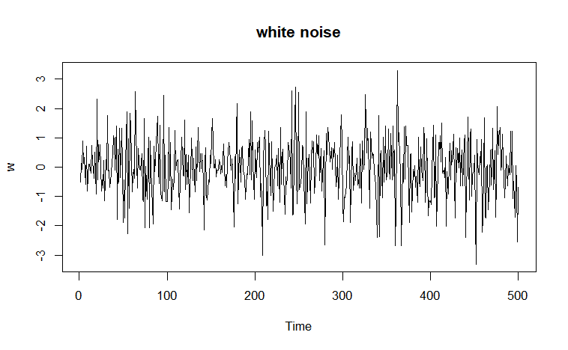
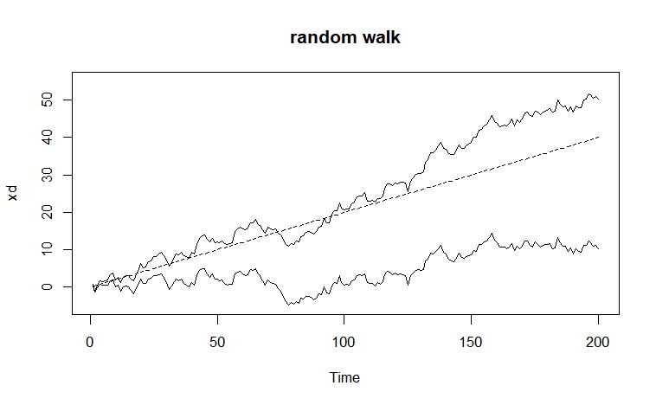
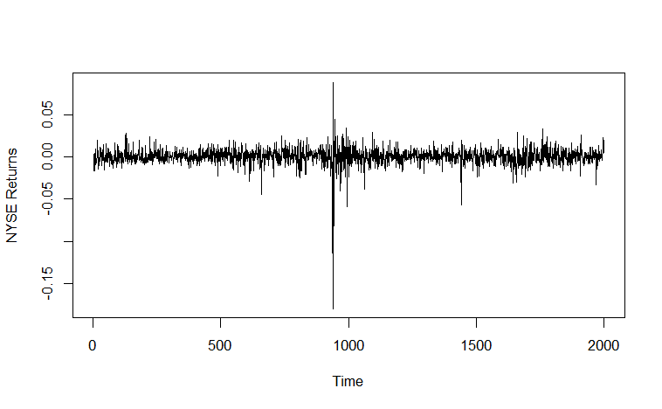
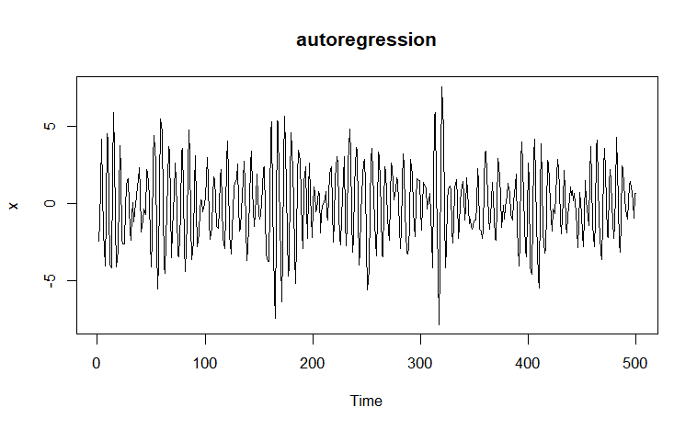
Background of Time Series Analysis
Real World Examples
Model Generated Examples
Global warming
New Yorker Stock Exchange

Slide 5
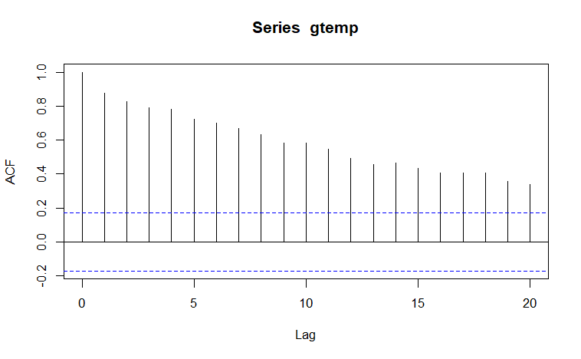
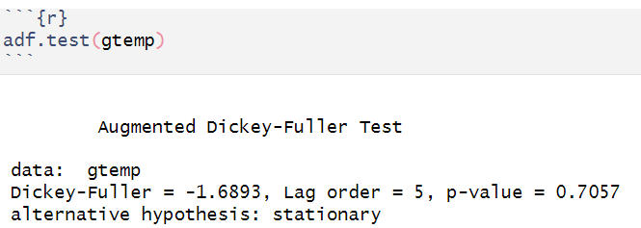
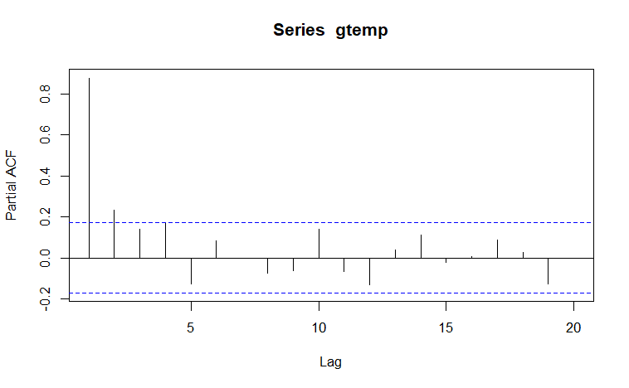
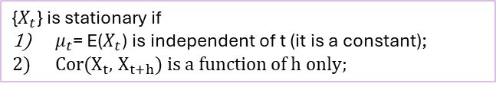
Stationary
Background of Time Series Analysis
{$X_{t}$} is stationary if
$μ_{t}$= E($X_{t}$) is independent of t (it is a constant);
Cor($X_{t}$, $X_{t+h}$) is a function of h only;
This condition makes sure the data are homogeneous,
so that the data can be modeled.
The ways to check stationary: ACF & PACF
Notes:
After the data is obtained, the first step is to check stationary,

Slide 6
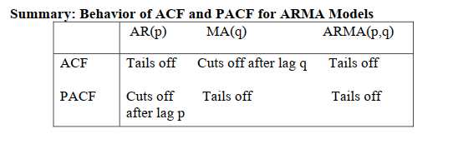
Background of Time Series Analysis
Tails off
Modeling selection for Global Warming: AR(2)
We are not sure whether there are other models appropriate for Global Warming
Cut off after lag=2
Notes:
What is outliers?
Outliers and anomalies can be used interchangeably.

Slide 7
Project Motivation
To address climate change, we can discover catalysts to develop new energy resources, on the other hand we also should save the current energy resources.
Predicting the electric power consumption precisely on demand can save energy.
The electric power distribution problem is the distribution of electricity to different areas depends on its sequential usage, but predicting the following demand of a specific area is difficult, as it varies with weekdays, holidays, seasons, weather, temperatures, etc.
It causes unnecessary waste of electricity and equipment depreciation.
There is one efficient strategy to solve this problem is to predict the electrical transformers’ oil temperature because the oil temperature can reflect the electricity transformer.
The dataset is historical records of oil temperatures measured at electricity distribution stations.
This project focuses on time series data analysis, forecasting model selection and evaluation.
https://github.com/zhouhaoyi/ETDataset
Notes:
What is outliers?
Outliers and anomalies can be used interchangeably.

Slide 8
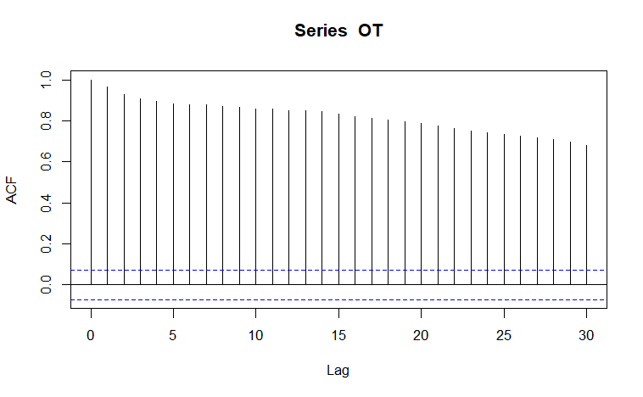
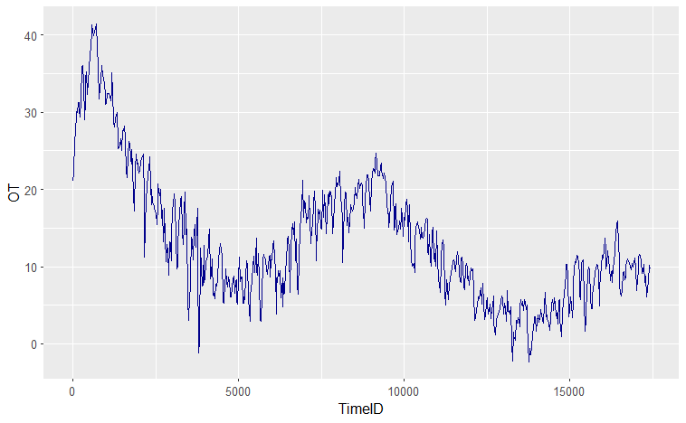
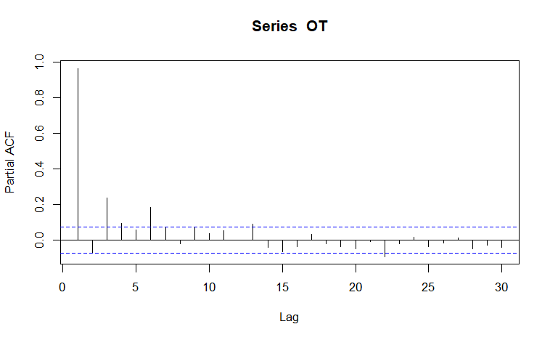
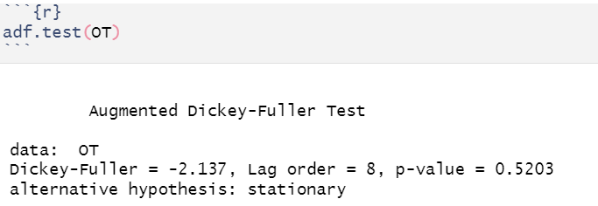
Data
Time | HUFL | HULL | MUFL | MULL | LUFL | LULL | OT
Days | High Useful Load | High Useless Load | Middle Useful Load | Middle Useless Load | Low Useful Load | Low Useless Load | Oil Temperature
Notes:
The dataset contains total 7 variables:
Tested stationary of oil temperature,
Checked ACF PACF

Slide 9
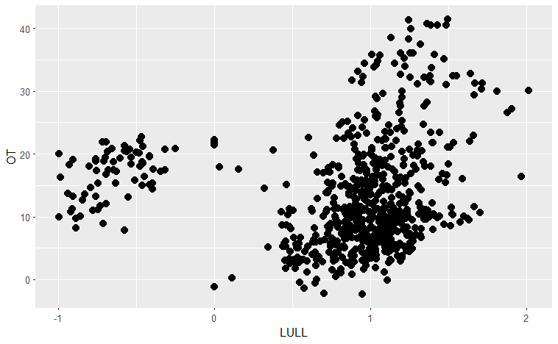
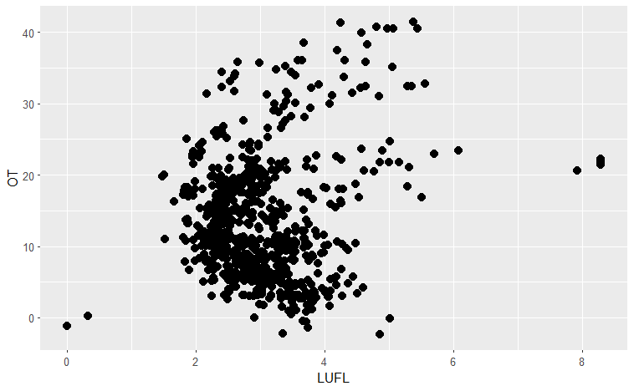
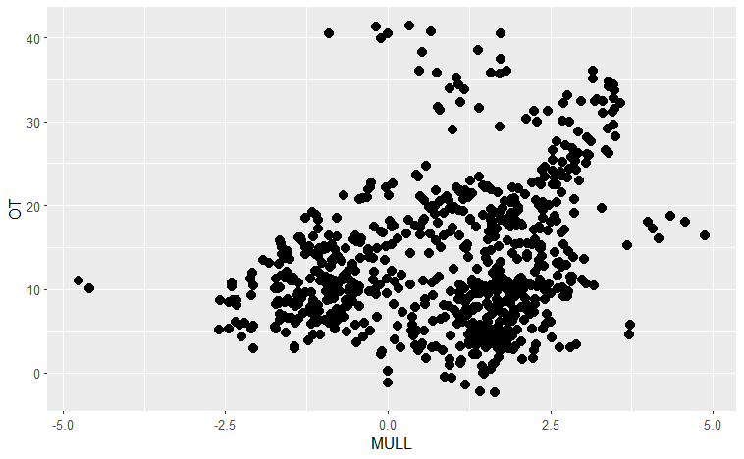
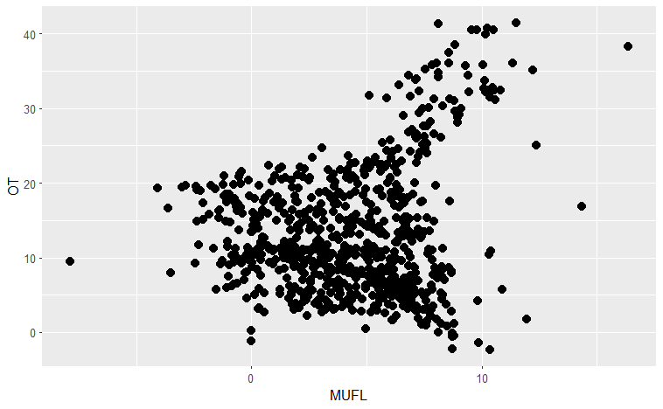
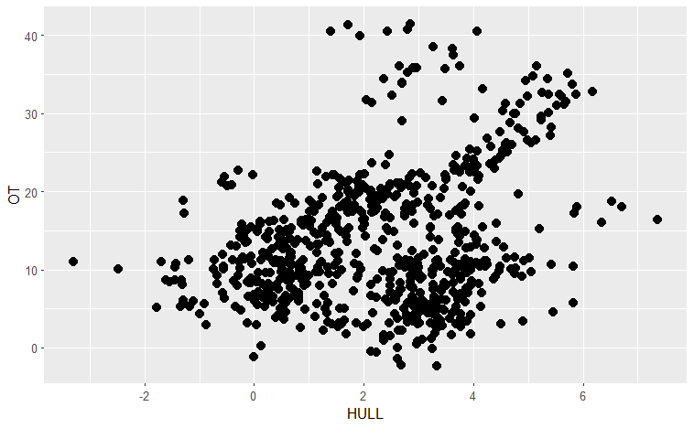
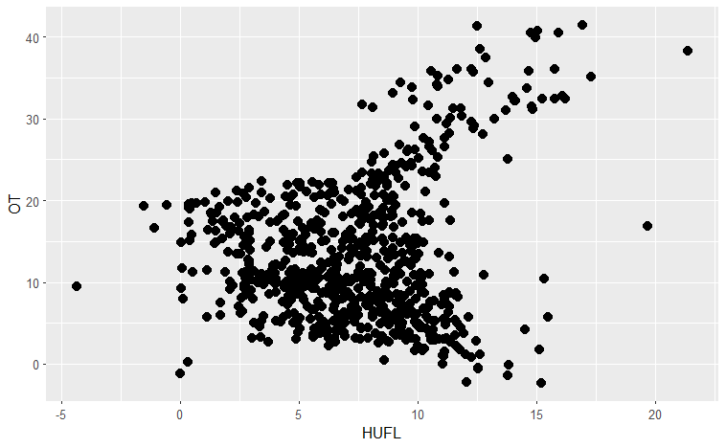
Data
Time | HUFL | HULL | MUFL | MULL | LUFL | LULL | OT
Days | High Useful Load | High Useless Load | Middle Useful Load | Middle Useless Load | Low Useful Load | Low Useless Load | Oil Temperature
LULL
LUFL
MULL
MUFL
HULL
HUFL

Slide 10
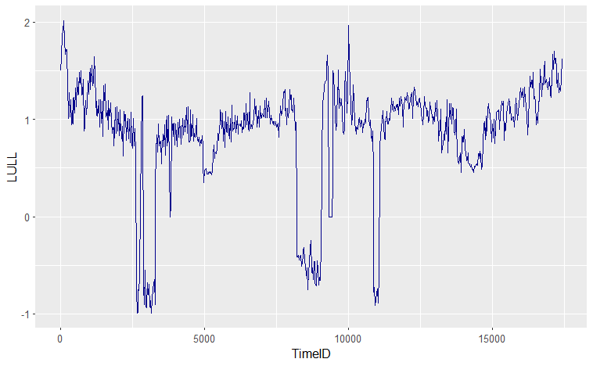
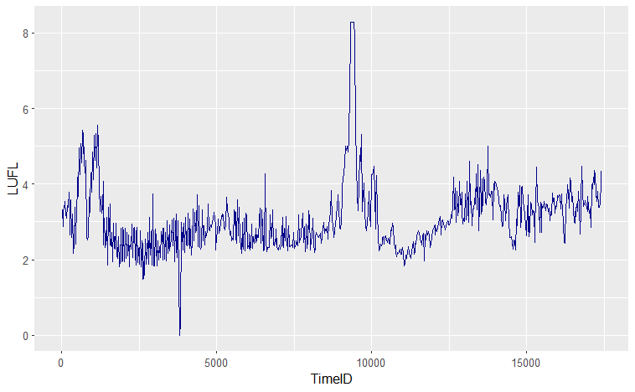
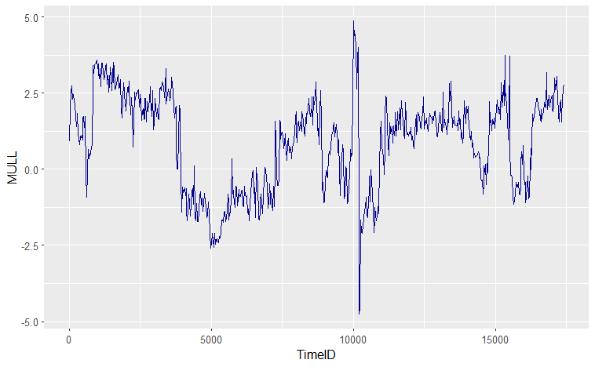
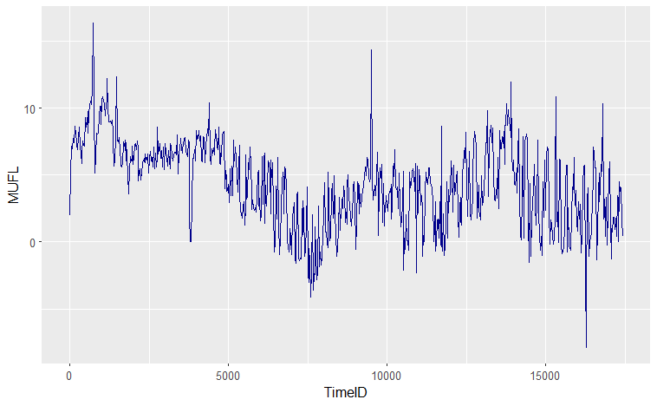
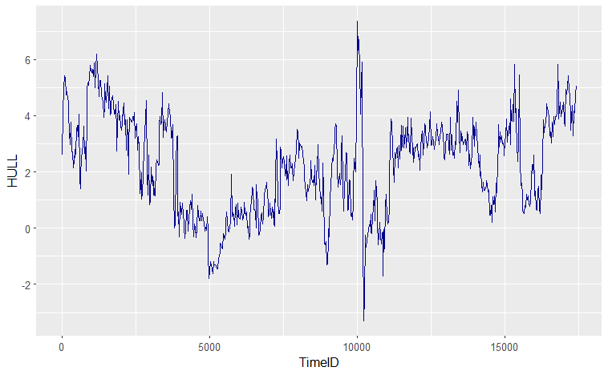
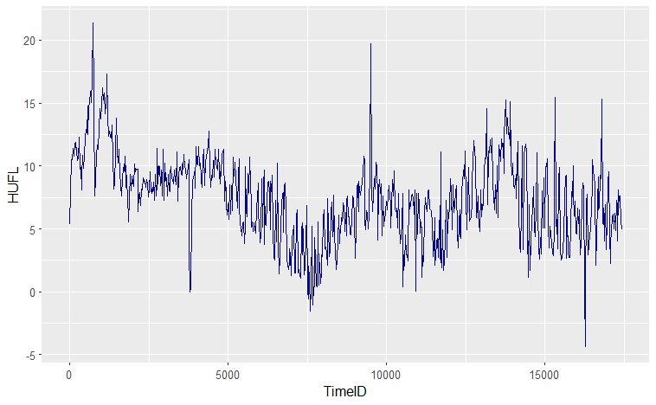
Data
Time | HUFL | HULL | MUFL | MULL | LUFL | LULL | OT
Days | High Useful Load | High Useless Load | Middle Useful Load | Middle Useless Load | Low Useful Load | Low Useless Load | Oil Temperature
LULL
LUFL
MULL
MUFL
HULL
HUFL

Slide 11
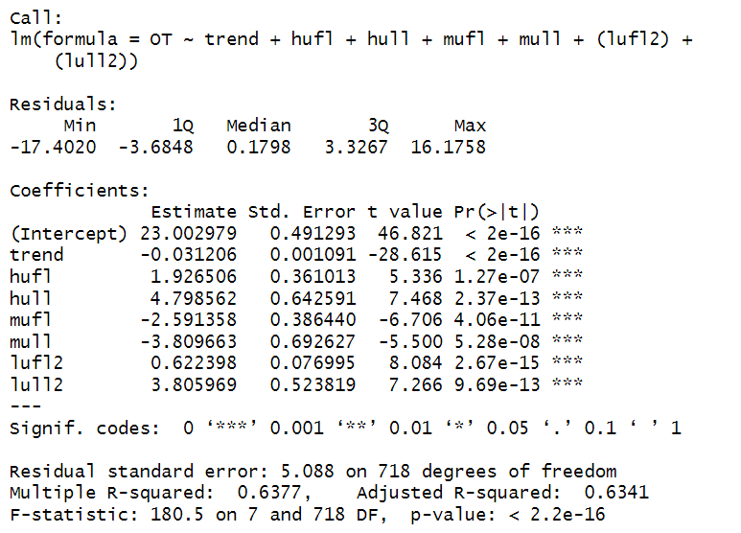
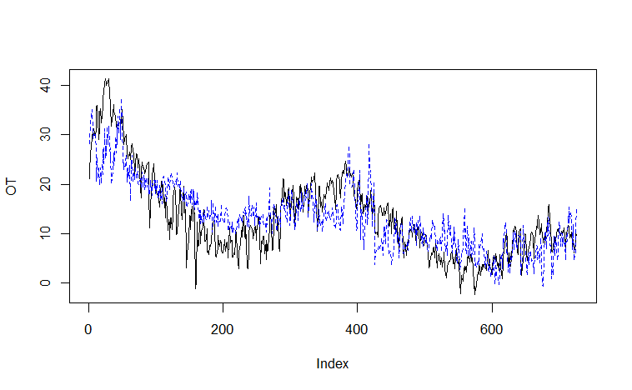
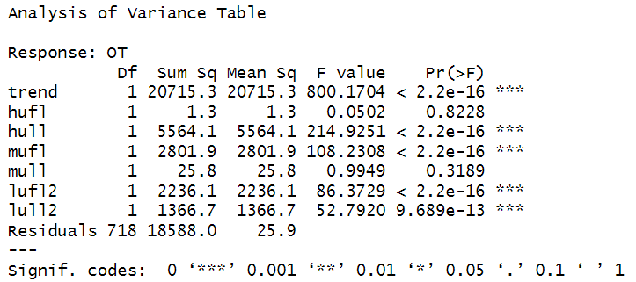
Models: Linear Regression
polynomial regression

Slide 12
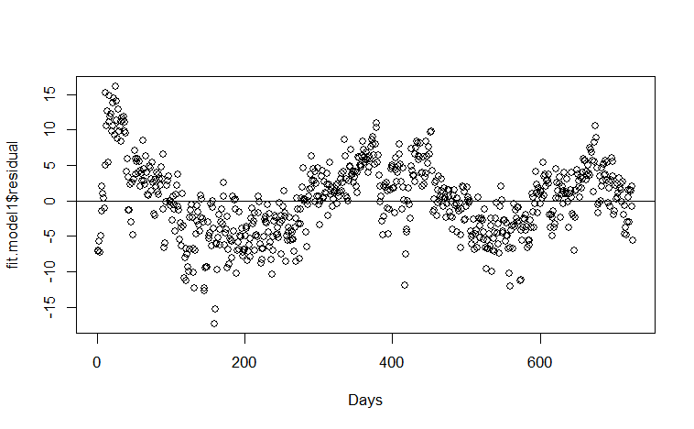
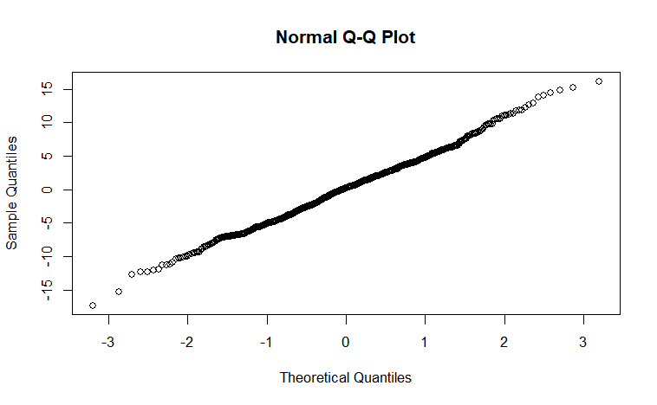
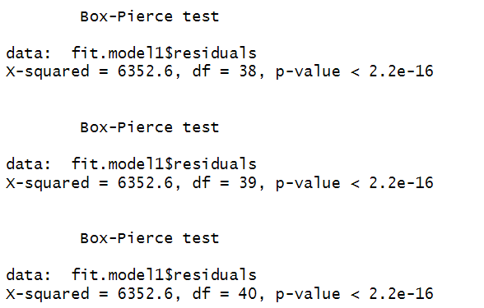
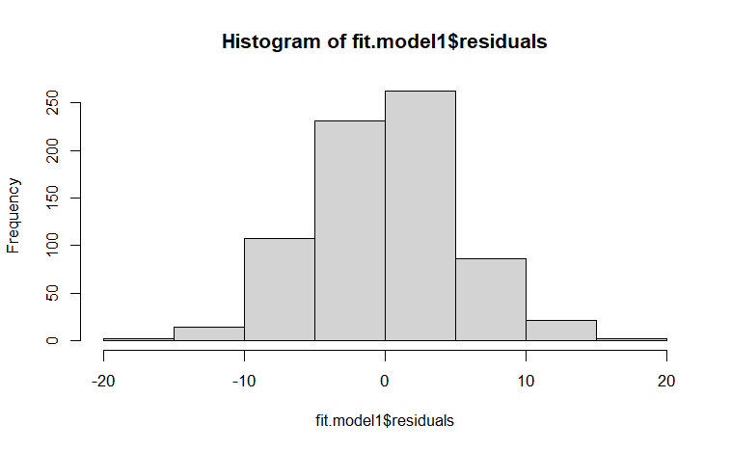
Models: Linear Regression
Check Residual IID
Check Residual Normality
Normal
Not IID

Slide 13
Models: Linear Regression
fit.model1 <- lm(OT ~ trend + hufl + hull + mufl + mull + (lufl2) + (lull2))
fit.model2 <- lm(OT ~ trend + hufl + hull + mufl + mull + (lufl +lufl2) + (lull +lull2))
fit.model3 <- lm(OT ~ trend + (hufl+hufl2) + (hull+hull2) + (mufl+mufl2) + (mull+mull2) + (lufl+lufl2) + (lull+lull2))
Model | AIC | BIC | AICc
Model_1 | 4.2675 | 4.3244 | 4.2594
Model_2 | 4.2669 | 4.3364 | 4.2533
Model_3 | 4.2515 | 4.3463 | 4.2269

Slide 14
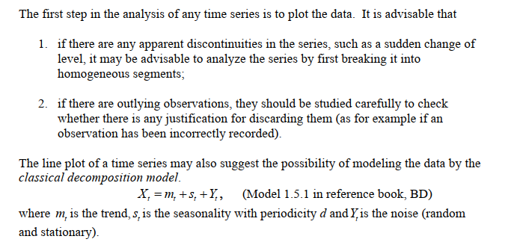
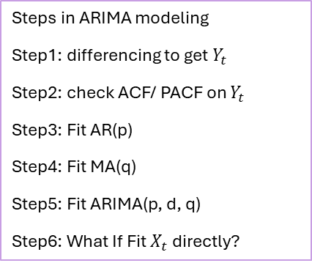
Models: ARIMA
Time series of Oil Temperature
Steps in ARIMA modeling
Step1: differencing to get $Y_{t}$
Step2: check ACF/ PACF on $Y_{t}$
Step3: Fit AR(p)
Step4: Fit MA(q)
Step5: Fit ARIMA(p, d, q)
Step6: What If Fit $X_{t}$ directly?

Slide 15
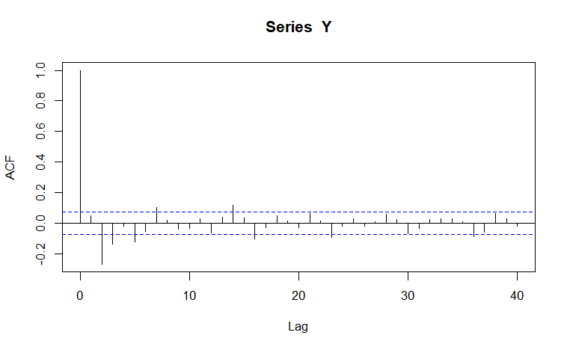
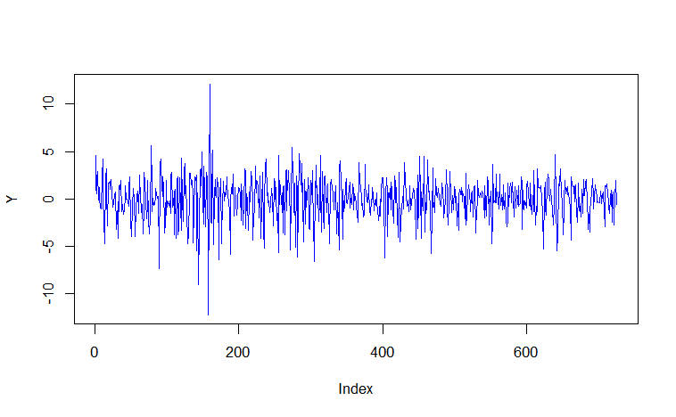
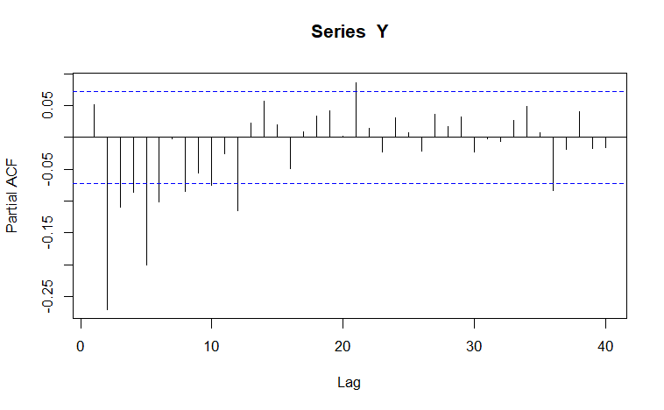

Models: ARIMA
differencing to get $Y_{t}$= $X_{t}$ - $X_{t−1}$
MA(q = 2)
AR(p = 8)

Slide 16
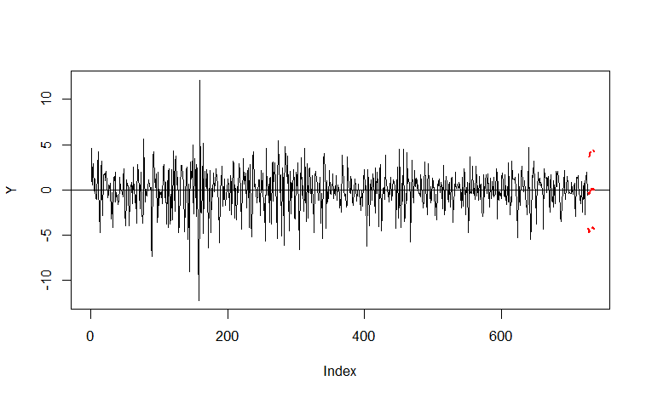
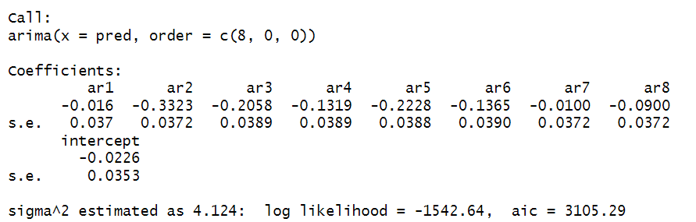
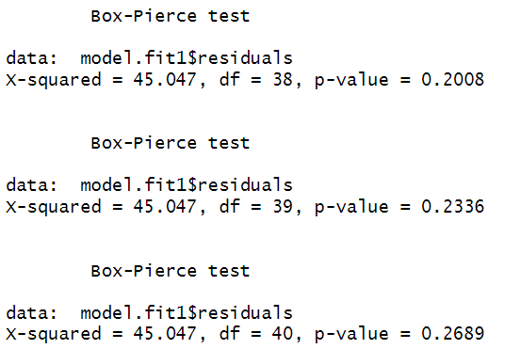
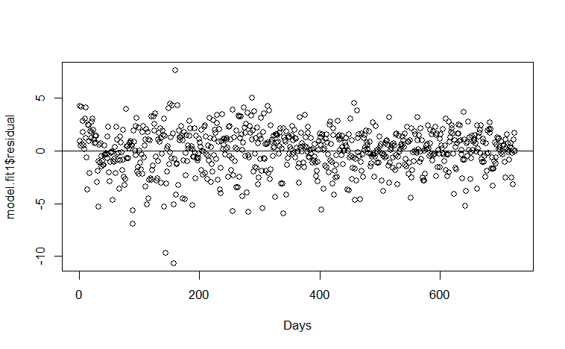
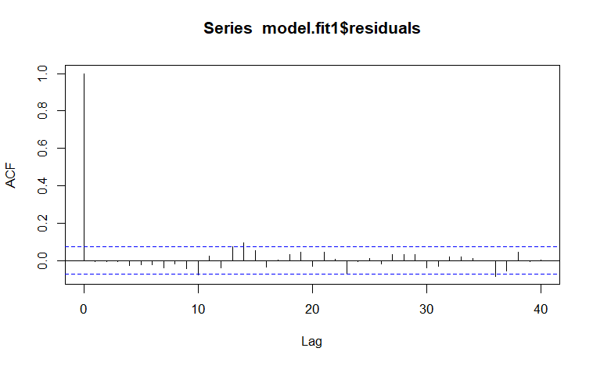
AR(p = 8)
model.fit1 <- arima(pred, order=c(8, 0, 0))
IID
Normal

Slide 17
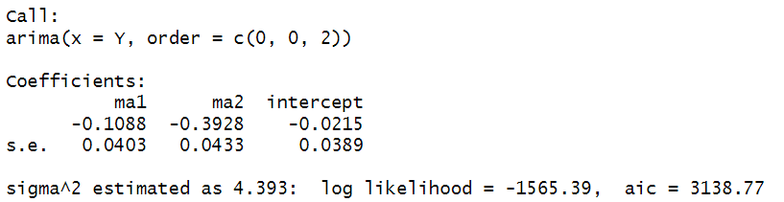
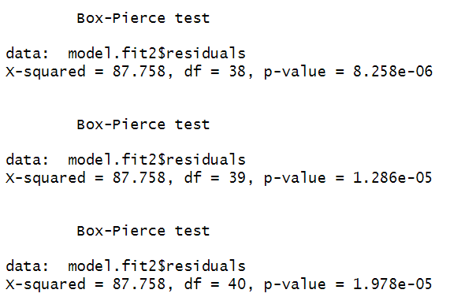
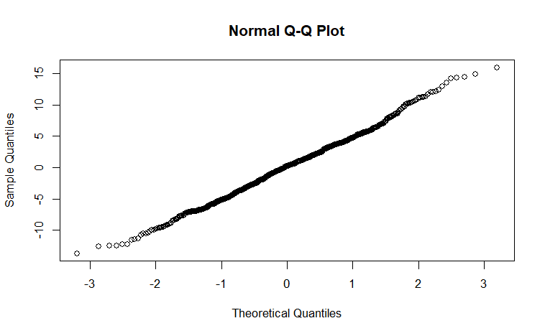
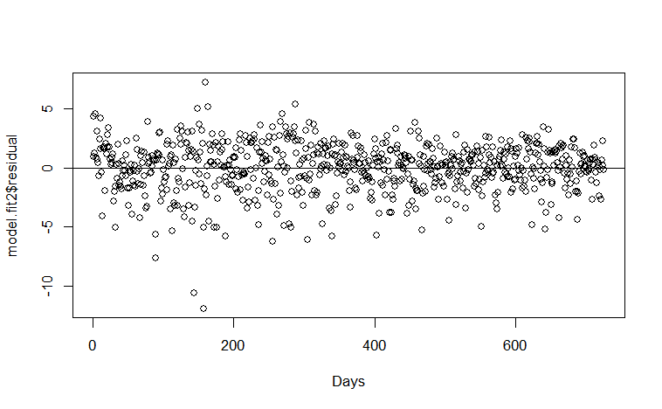
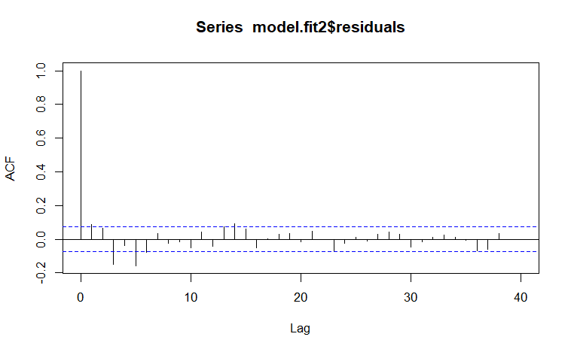
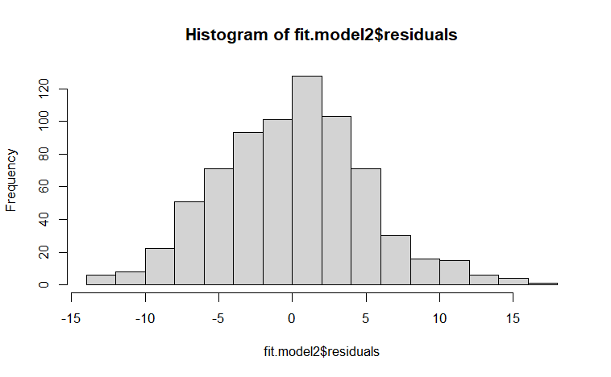
MA(q = 2)
model.fit2 <- arima(Y, order=c(0, 0, 2))
Not IID
Normal

Slide 18
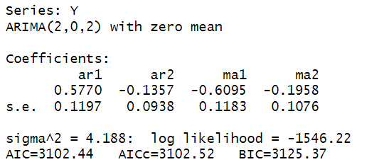





ARMA(p, q)
auto <- auto.arima(Y, d=0, ic="aicc", trace=T)
IID
Normal

Slide 19






ARMA(p, q) on Xt
OT.fit1 <- auto.arima(OT, trace=T, ic="aicc")
IID
Normal

Slide 20
model.fit1 <- arima(pred, order=c(8, 0, 0))
num <- length(OT)
# AIC
AIC(OT.fit1)/num - log(2*pi)
# BIC
AIC(OT.fit1, k=log(num))/num - log(2*pi)
# AICc
log(sum(resid(OT.fit1)^2)/num) + (num +5)/(num -5 -2)
model.fit2 <- arima(Y, order=c(0, 0, 2))
auto <- auto.arima(Y, d=0, ic="aicc", trace=T)
auto2 <- auto.arima(Y, ic="aicc", trace=T)
OT.fit1 <- auto.arima(OT, trace=T, ic="aicc")
Model | AIC | BIC | AICc
AR(p = 8) on Yt | 2.4394 | 2.5026 | 2.4322
MA(q = 2) on Yt | 2.4855 | 2.5108 | 2.4952
ARIMA(2,0,2) on Yt | 2.4354 | 2.4670 | 2.4421
ARIMA(2,1,2) on Xt | 2.4354 | 2.4670 | 2.4421

Slide 21
Conclusion
Linear Regression Models
Residual Assumption of IID is not satisfied, so linear regression may not a good choice.
ARIMA
ARIMA(2, 0, 2) is the best choice.
More details will be covered in final report
Causality, invertibility,
ARFIMA (long memory process)
Check whether ARCH, GARCH model are applicable

Slide 22
THANKS
Q & A

